Slide 1
Digital Diabetes Services Training Drop in sessions

Slide 2
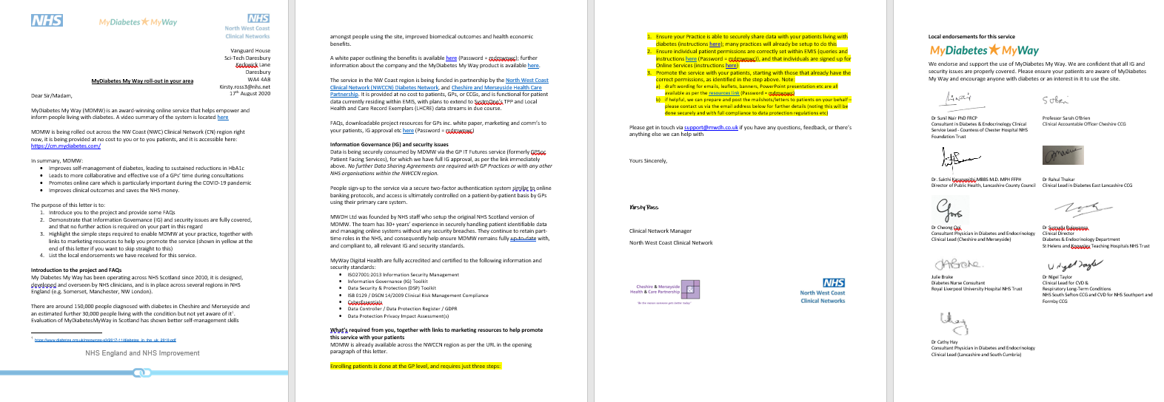
Slides will be sent after the event
Please make sure we have your contact details
(GPs should already have received a letter with all this info)

Slide 3
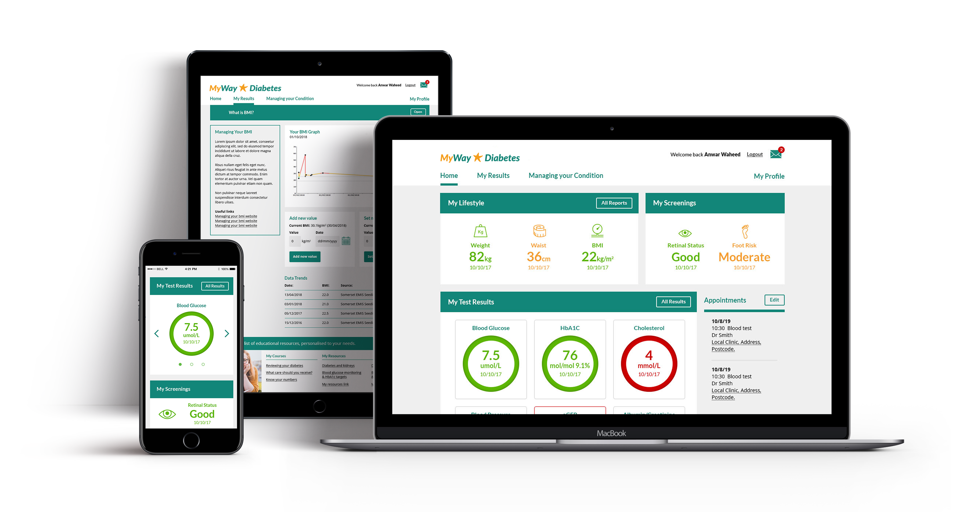
MyWay Diabetes – Summary -
Funded by C&M Health Care Partnership and NHSE/Improvement
Improves learning and self-management for people living with diabetes ➔ up to 150,000 people living with T1 & T2 diabetes in C&M
Access to tailored info, care targets, accredited structured education etc
Covid-19 ➔ promotes remote care, and helps a high-risk group manage their condition
Informed patients ➔ better use of Healthcare Professionals’ time

Slide 4
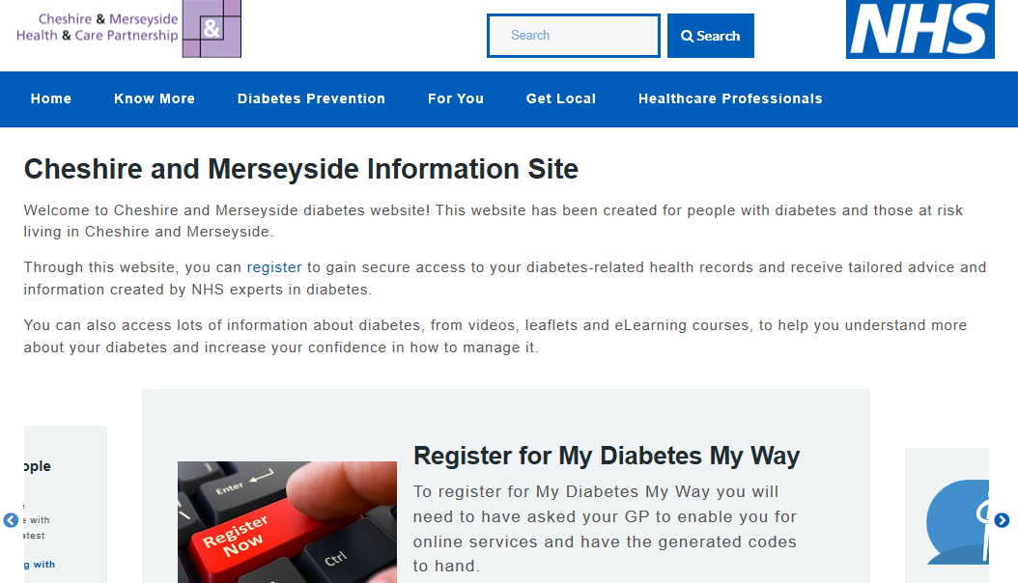
Who can use it?
Anyone living with diabetes (T1 & T2), their families and carers.

Slide 5
E-Learning Courses
* available now *
MyWay Diabetes- Overview for your colleagues
Patient data access * permission must be granted by GPs *
QISMET accredited structured education:
My Type 2 Diabetes
Understanding Type 1 Diabetes
Growing up with Type 1
Considering an Insulin Pump?
My Insulin Pump
My Gestational Diabetes
Carbohydrate Counting
Type 2 Diabetes Prevention
MyWay Diabetes patient access:
Access diabetes-related health data
Simple explanation of test results
Tables and graphs of key measures
Tailored advice on how to improve self-management
Personalised care reports
What’s provided:
Benefits for Patients:
Increase knowledge about their diabetes
Understanding the impact of their choices
Quizzes and interactive content to enhance learning
Benefits for Patients:
Benchmark their diabetes vs. best practice guidance
Encouraged to set goals
Informed discussion with clinicians
Access to peer and NHS staff support
24/7 access
Patient benefits:
HCP Direct Referral:
Register your patient's details for an online account, select your Practice from the drop-down list.
cm.mydiabetes.com/register-patient
lsc.mydiabetes.com/register-patient
Patient Self-Referral
HCP: Enabling Record Access for Patients:
Online services enabled and set to Detailed Coded Record, with Lab results, Immunisations & Problems ticked.
For more info visit
https://cm.mydiabetes.com/healthcare-professionals/
https://lsc.mydiabetes.com/healthcare-professionals/
Signing up:
Patient’s can self refer to both the patient data access and eLearning courses at:
cm.mydiabetes.com
lsc.mydiabetes.com

Slide 6
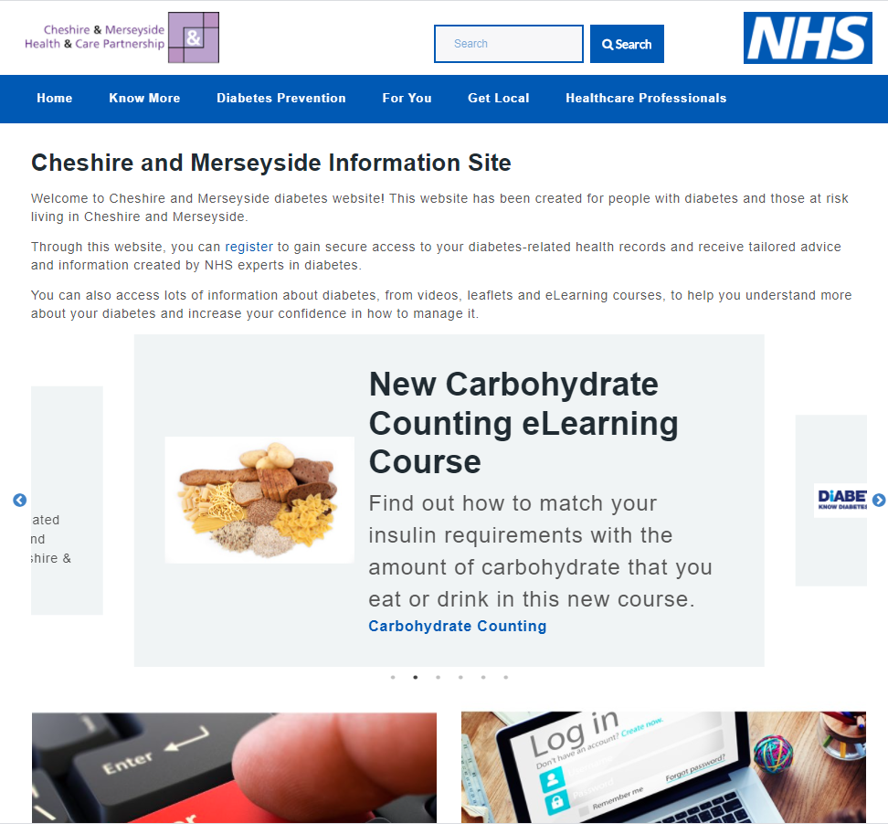
What MyWay Diabetes provides – 1. Diabetes info & local services

Slide 7
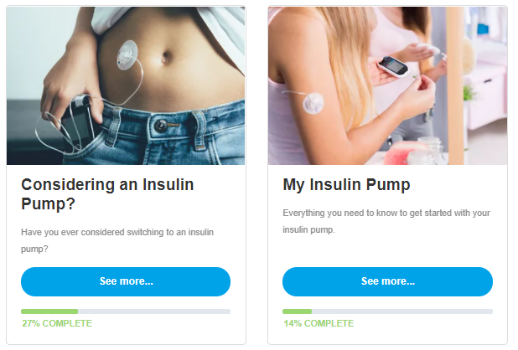
2. Structured eLearning
QISMET accreditation enables both QOF and NDA coding/reporting

Slide 8
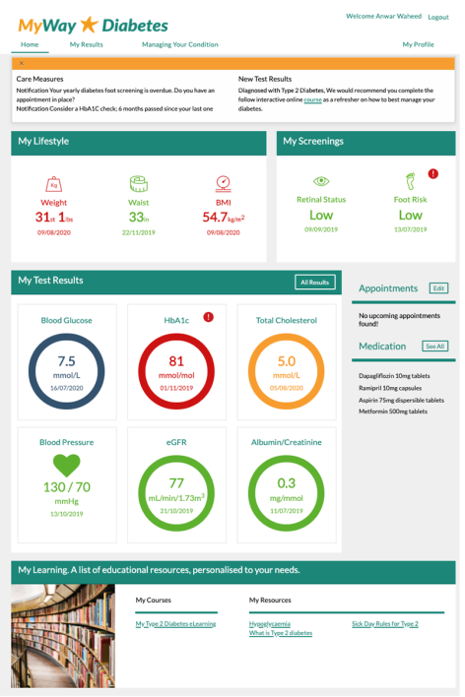
3. Patient
Dashboard
“I use MDMW to monitor my BP, cholesterol and sugar levels. Seeing it on a chart gives you the opportunity to see your improvements or areas where you need to work harder”

Slide 9
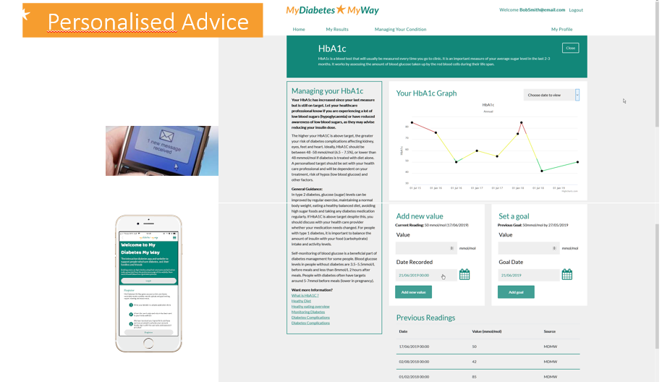
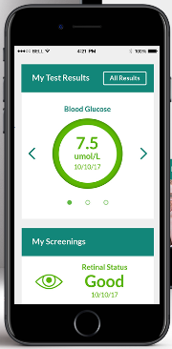
4. Tailored advice and support
Tailored, data driven, content & Links

Slide 10
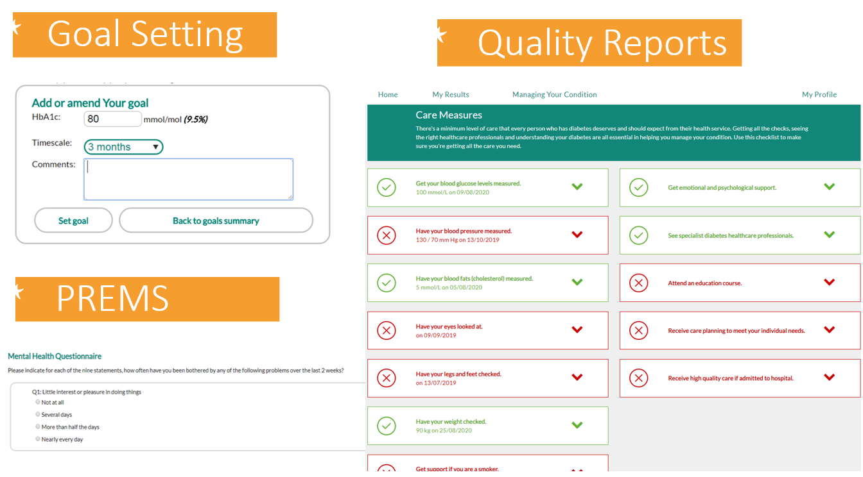
5. Goals and Care Reports

Slide 11
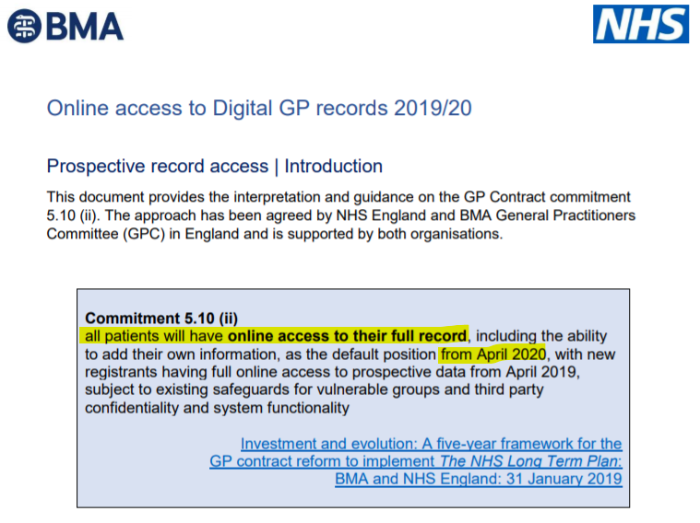
Enabling Online Services (primary care)
[NHS England’s GPs’ contracts - practices need to be providing online access to all patients from April 20 - MDMW is simply plugging in to this]

Slide 12
Next Steps
Primary Care –
Enable Online Services, and MyWay Diabetes for data sharing …Then…
Setup individual patient permissions, or Watch for announcements - new/simplified data flows being established as we speak
Healthcare professionals –
Advertise MyWay Diabetes - colleagues / networks / patients
Refer patients for structured eLearning
Resource pack available (leaflets, PPT, website etc)
Provide content for local services pages
Patients – register for Online Services, and MyWay Diabetes

Slide 13
Summary
Diabetes My Way website
Main site: https://cm.mydiabetes.com/
Resources file: https://mywaydigitalhealth.co.uk/mdmw-nwc/
Enabling records access: https://cm.mydiabetes.com/healthcare-professionals/
Demo: Video here, and/or request eLearning account here
General project enquiries, suggestions and feedback
alex.pegg1@nhs.net
Technical enquiries for patients:
support.myway@nhs.net
Thanks for listening!

Slide 14
Primary care detailed coded record slides

Slide 15
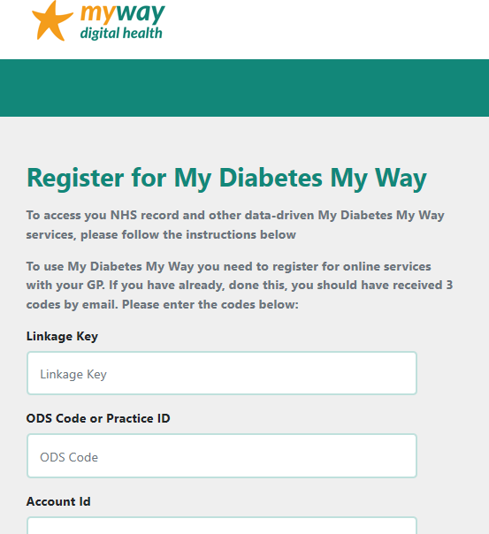
Your task: Setting access permissions
GPs control data access permissions via:
Records access for practices: (done once) – Enable Online Services with Detailed Coded Record, and all options enabled (Documents are optional)
Records access for patients: (per patient) - set to Detailed Coded Record, with Lab results, Immunisations & Problems enabled (as shown on next slide)
My Diabetes My Way does not require free text, only coded entries with numeric values.
Register for MyWay Diabetes
To access your NHS record and other data-driven MyWay Diabetes services, please follow the instructions below.
To use MyWay Diabetes you need to register for online services with your GP. If you have already done this, you should have received 3 codes by email. Please enter the codes below:

Slide 16
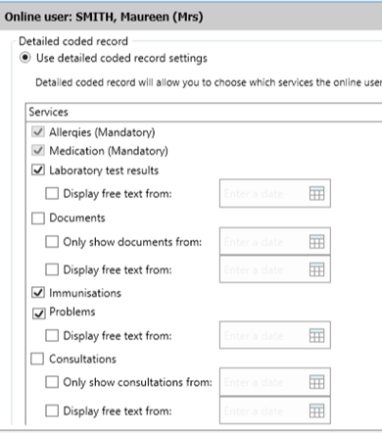
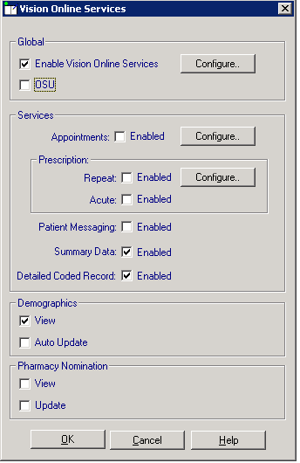
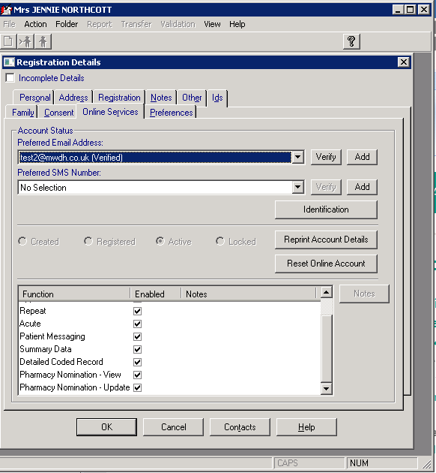
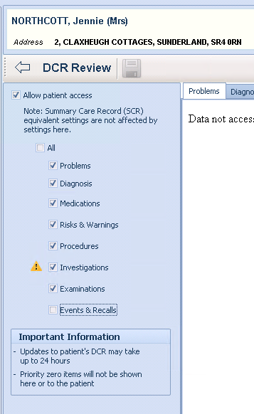
Detailed coded record settings
EMIS
Vision

Slide 17
Next Steps: GP Practices
Identify & set patient permissions - over 18, living with T1 & T2 diabetes, and review for any exclusions. EMIS query templates available here
Notify them – e.g. text, email, or letter inviting them to MyWay Diabetes, and/or add into existing EMIS patient comm’s
standard templates and EMIS comm’s instructions provided
can be coded as referral to structured education (QOF)
---------------------------------------------------------------------------------------------------------------
Share info on MyWay Diabetes –
Amongst your team and networks
With patients via leaflets, PPT, website etc
Provide content for local services pages?
Feedback and help - alex.pegg1@nhs.net

